Slide 1
Mathematics

Slide 2
Characteristics of Modular Operators
(A + B)mod N = [(A mod N)+(B mod N)] mod N
(A * B) mod N = [(A mod N)*(B mod N)] mod N
(A - B) mod N = [(A mod N)-(B mod N)] mod N
(A - B) mod N = [(A mod N)-(B mod N) + n] mod N
/ : modular inverse

Slide 3
Exponential Operation 11⁷ mod 13
11² mod 13 = 121 mod 13 = (130 – 9) mod 13
= 0 + (- 9) mod 13 = 4 mod 13
11⁴ mod 13 = 4² mod 13
= (13 mod 13) + (3 mod 13)
= 3 mod 13
11⁷ mod 13 = (11 mod 13) (4 mod 13) (3 mod 13)
= (11 mod 13) (12 mod 13)
= 132 mod 13
= 2 mod 13

Slide 4
Characteristics of Modular Operators
a = 11, b = 15, n = 8
1. (a + b) mod n
= ((11 mod 8) + (15 mod 8)) mod 8
= 3 + 7 mod 8
= 10 mod 8 = 2
2. (a - b) mod n
= ((11 mod 8) - (15 mod 8)) mod 8
= 3 - 7 mod 8
= -4 mod 8 = 4
3. (a * b) mod n
= ((11 mod 8) * (15 mod 8)) mod 8
= 3 * 7 mod 8
= 21 mod 8 = 5

Slide 5
Greatest common divisor
GCD(x, y)
The greatest common divisor (gcd) of two or more integers, which are not all zero, is the largest positive integer that divides each of the integer
for i in range(2, min(x,y)) :
if x%i ==0 and y%i==0 : gcd = i

Slide 6
GCD : Euclidean Algorithm
The first algorithm
gcd(a, b) = gcd(b, a mod b)
For example,
a = 105, b = 30
gcd(105, 30) = gcd(30,105 mod 30) = gcd(30, 15)
= gcd(15, 30 mod 15) = gcd(15, 0)
gcd(15, 0) = 15
∴ gcd(105,30) = 15

Slide 7
Euclidean Algorithm
def GCD1(a, b):
if b==0 : return a
else : return GCD1(b,a%b)
print(GCD1(12, 8))
def GCD2(a, b):
while b!=0:
r = a%b
a = b
b = r
return a

Slide 8
Least Common Multiple
82320 = 2⁴ ⋅ 3¹ ⋅ 5¹ ⋅ 7³ ⋅ 11⁰
950796 = 2² ⋅ 3² ⋅ 5⁰ ⋅ 7⁴ ⋅ 11¹
lcm(82320, 950796) = 2⁴ ⋅ 3² ⋅ 5¹ ⋅ 7⁴ ⋅ 11¹ = 19015920

Slide 9
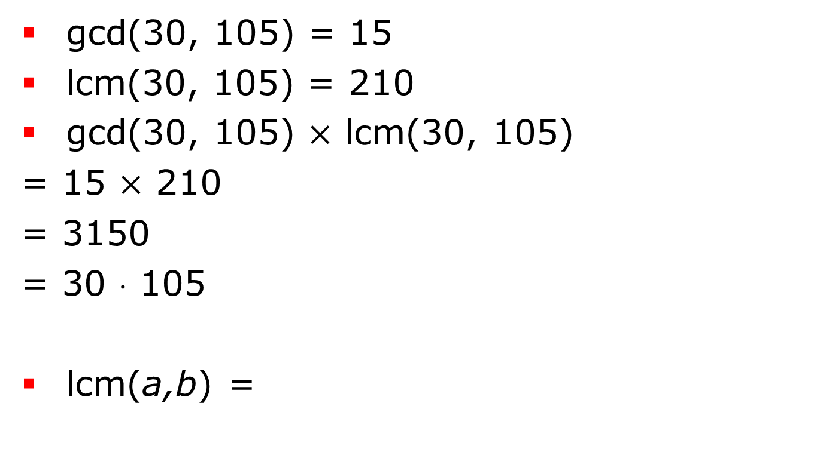
LCM
gcd(30, 105) = 15
lcm(30, 105) = 210
gcd(30, 105) $×$ lcm(30, 105)
= 15 $×$ 210
= 3150
= 30 ⋅ 105
lcm(a,b) =
ab
gcd(a,b)

Slide 10
Prime Number
A prime number is a whole number greater than 1 whose only factors are 1 and itself.
A factor is a whole numbers that can be divided evenly into another number.
The first few prime numbers are 2, 3, 5, 7, 11, 13, 17, 19, 23 and 29.
Numbers that have more than two factors are called composite numbers.
The number 1 is neither prime nor composite.

Slide 11
Prime Number O(n)
def prime(n):
if n<2: return False
for i in range(2, n):
if n%i ==0 : return False
return True

Slide 12
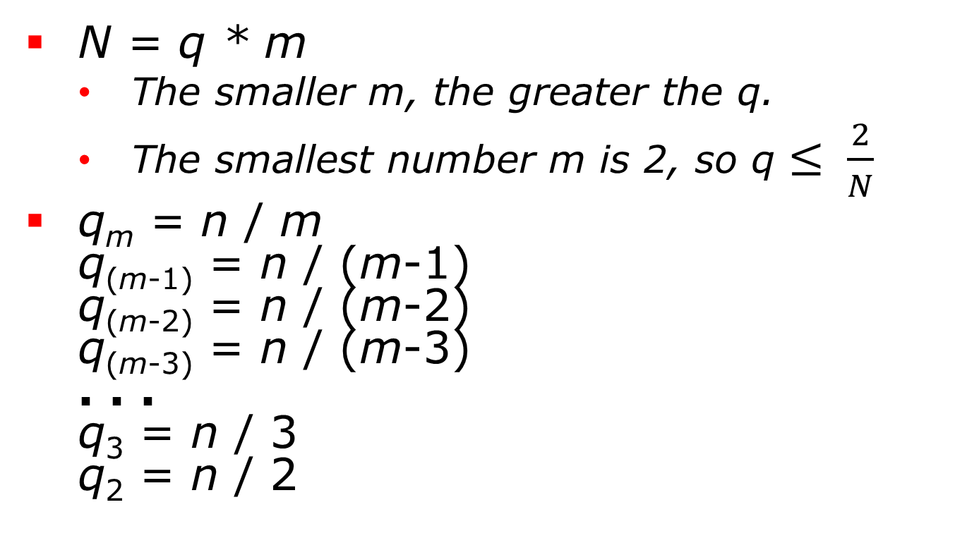
Prime Number
N = q * m
The smaller m, the greater the q.
The smallest number m is 2, so q $≤ \frac{2}{N}$
q_{m} = n / m q_{(m-1)} = n / (m-1) q_{(m-2)} = n / (m-2) q_{(m-3)} = n / (m-3) . . . q₃ = n / 3 q₂ = n / 2

Slide 13
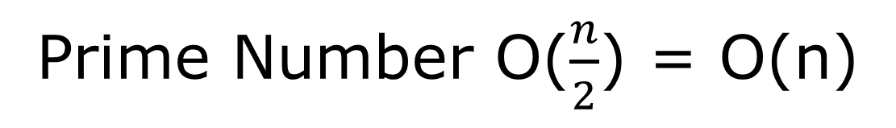
Prime Number O($\frac{n}{2}$) = O(n)
def prime(n):
if n<2: return False
for i in range(2, n//2+1):
if n%i ==0 : return False
return True

Slide 14
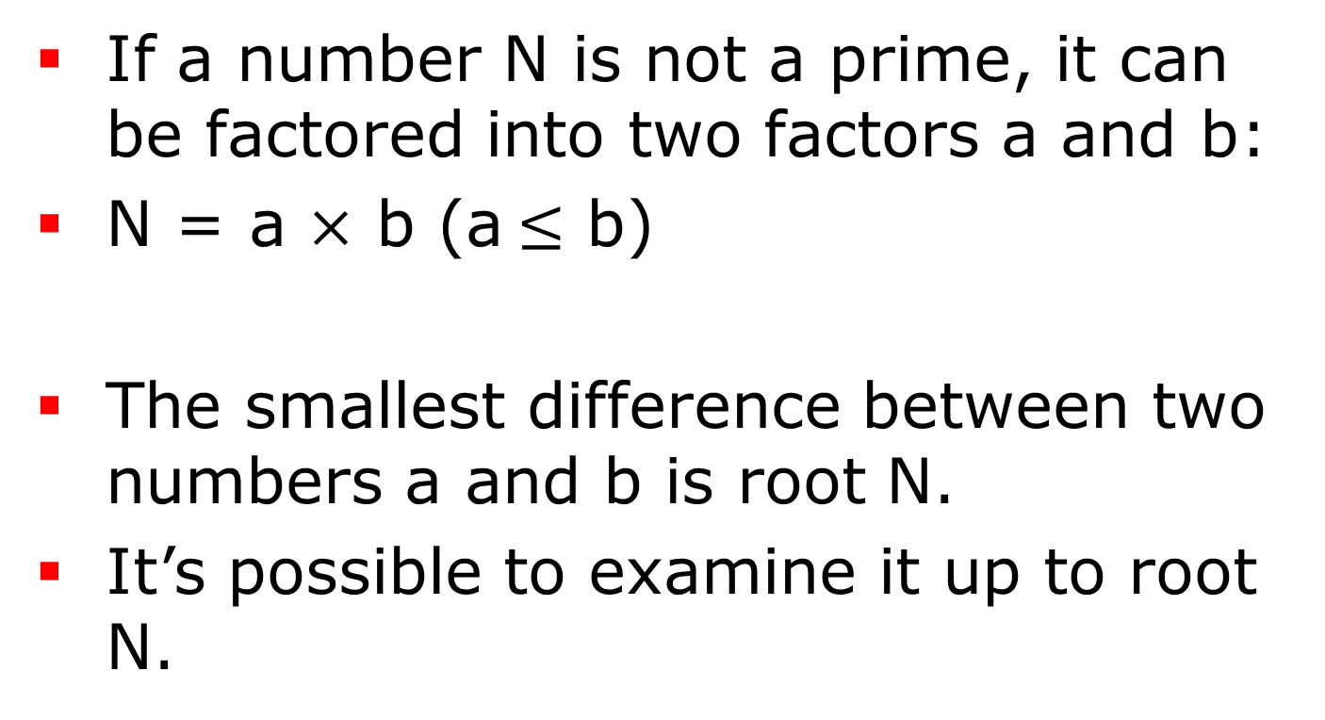
Prime Number
If a number N is not a prime, it can be factored into two factors a and b:
N = a $×$ b (a$≤$ b)
The smallest difference between two numbers a and b is root N.
It’s possible to examine it up to root N.

Slide 15
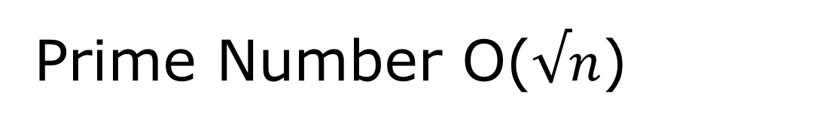
Prime Number O($√n$)
def prime3(n):
if n<2: return False
i = 2
while i*i<=n :
if n%i ==0 : return False
i+=1
return True

Slide 16

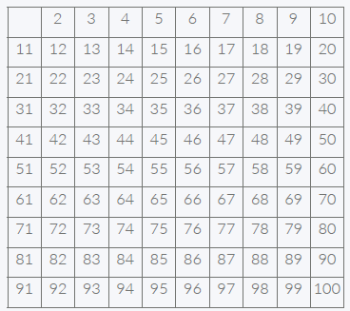
Seive of Eratosthemes
Make a list of all the integers less than or equal to n (and greater than one). Strike out the multiples of all primes less than or equal to the square root of n, then the numbers that are left are the primes.

Slide 17
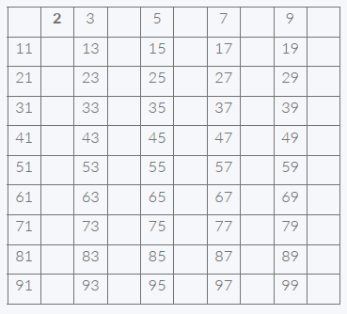
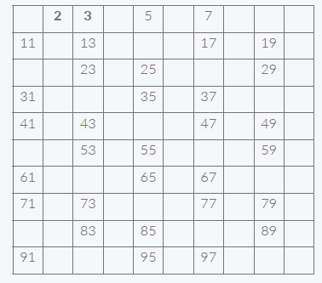
Seive of Eratosthemes
The first number 2 is prime, so keep it and cross out its multiples.
The first number left is 3, so it is the first odd prime. Keep it and cross out all of its multiples. We know that all multiples less than 9 (i.e. 6) will already have been crossed out, so we can start crossing out at 3²=9.

Slide 18
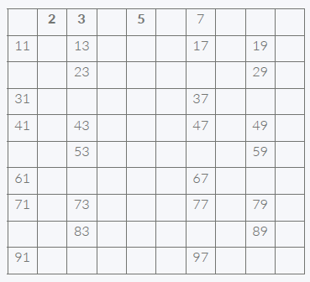
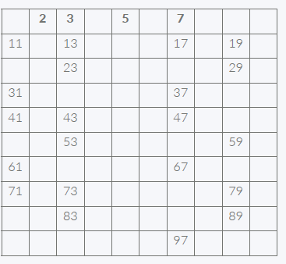
Seive of Eratosthemes
Now the first number left is 5, the second odd prime. So keep it also and cross out all of its multiples (all multiples less than 5²=25 have already been crossed out, so we can start crossing out at 5²=25)
The next number is 7

Slide 19
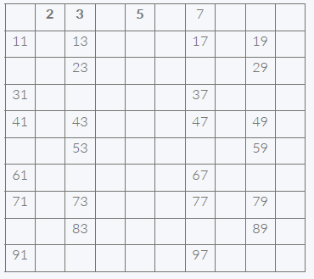
Seive of Eratosthemes
The next number left, 11, is larger than the square root of 100, so there are no multiples of 11 to cross off that haven't already been crossed off (22,44,66 and 88 by 2, and 33,66,99 by 3, and 55 by 5, and 77 by 7), and therefore the sieve is complete. Therefore all of the numbers left are primes

Slide 20
Seive of Eratosthemes
IsNotPrime = [0]*101
Prime = [0]*101
primeIdx = -1
IsNotPrime[0] =IsNotPrime[1] = True
for now in range(2,101):a
if IsNotPrime[now]==False :
primeIdx+=1
Prime[primeIdx] = now
for i in range(now*now, 101, now):
IsNotPrime[i] = True
print(Prime)

Slide 21
Seive of Eratosthemes

Slide 22
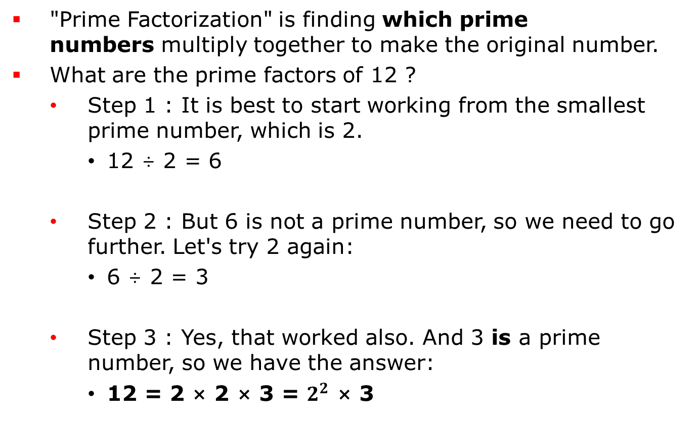
소인수분해
"Prime Factorization" is finding which prime numbers multiply together to make the original number.
What are the prime factors of 12 ?
Step 1 : It is best to start working from the smallest prime number, which is 2.
12 ÷ 2 = 6
Step 2 : But 6 is not a prime number, so we need to go further. Let's try 2 again:
6 ÷ 2 = 3
Step 3 : Yes, that worked also. And 3 is a prime number, so we have the answer:
12 = 2 × 2 × 3 = $2^{2}$ × 3

Slide 23
소인수분해
now = 2
num = n
while now*now<=n :
while num%now ==0 :
print(now)
num/=now
now+=1

Slide 24
문제풀어보기
2609 : 최대공약수 최소공배수
소수
1929
4948
9020

